Slide 1
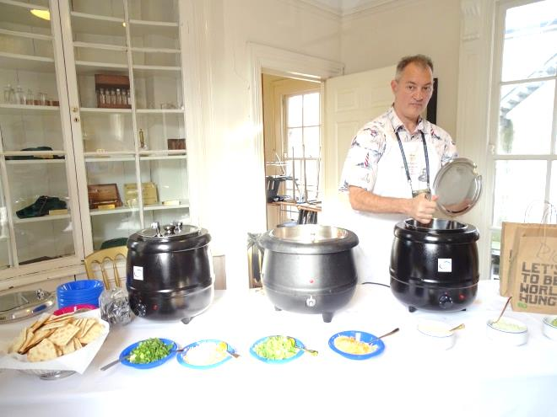
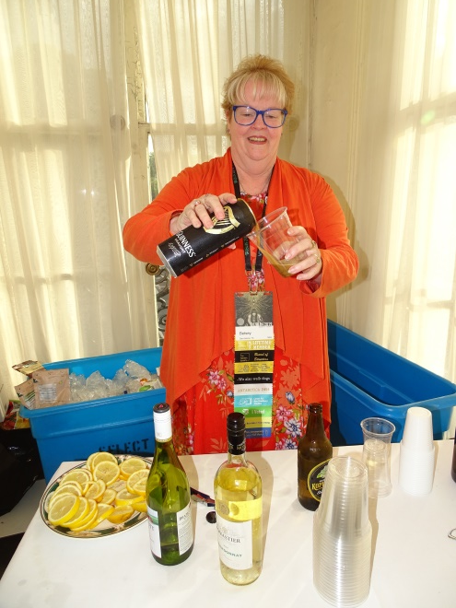
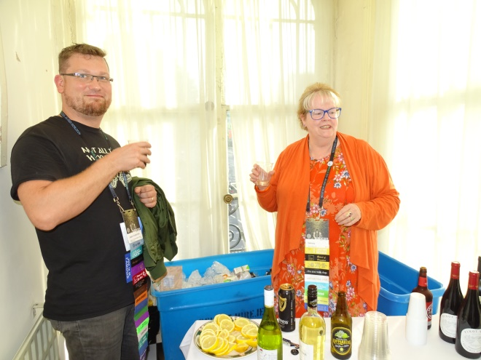
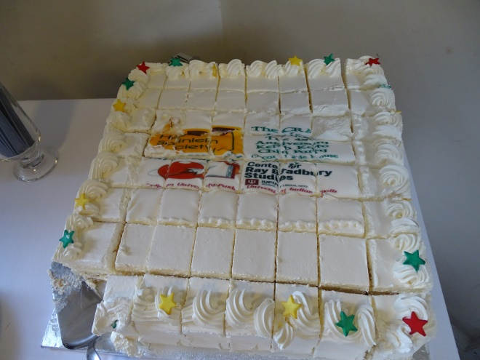
Member Alan Petrillo
on chili dispersal duty
Director Betsey Wilcox
Bartender-In-Chief
Jason Aukerman
on Quality Control duty
Bradbury-Heinlein-Kato
cake, as designed and executed.
“Craic” is Irish slang for “fun”

Slide 2
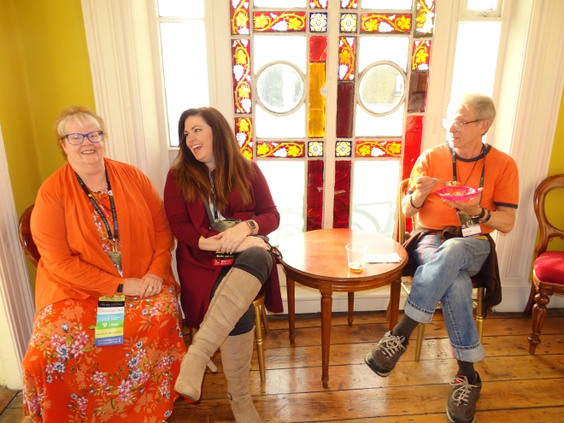
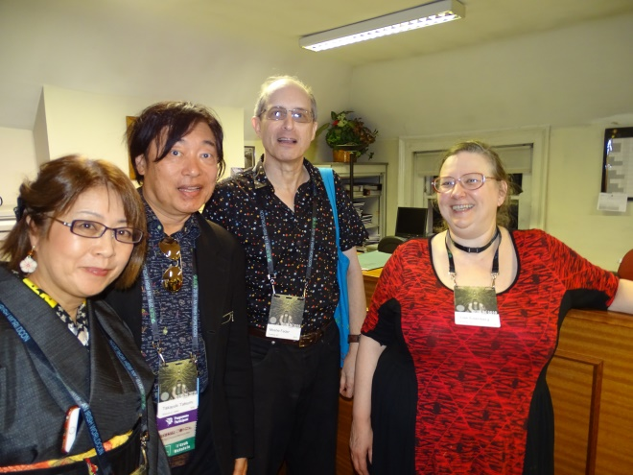
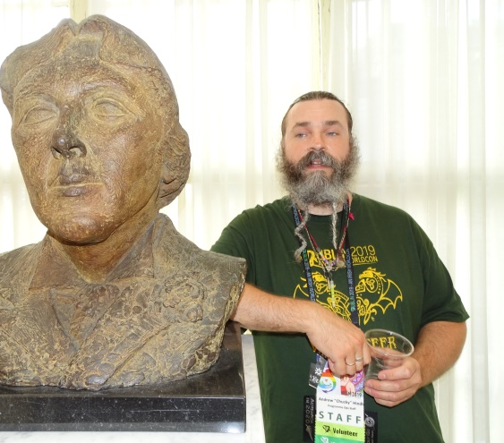
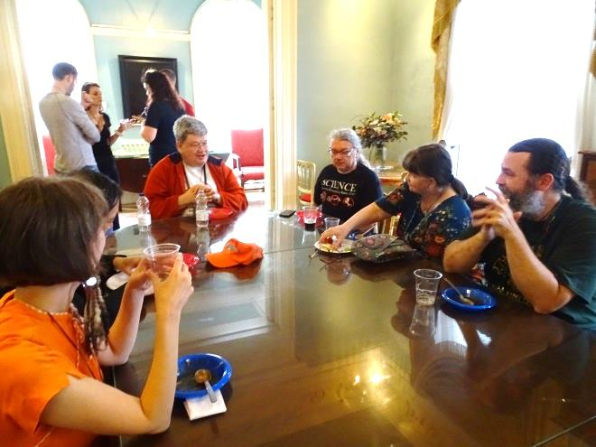
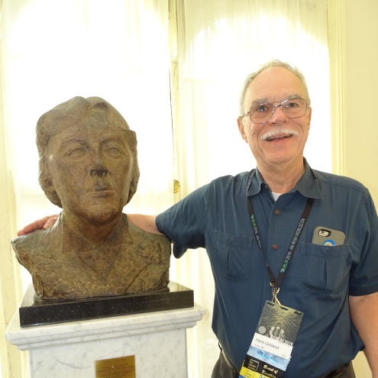
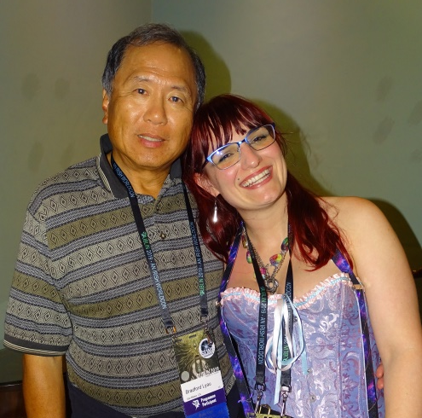
Guests Professors Mari Kotani (Meiji
University), Dr. Takayuki Tatsumi (Keio
University), Tor editor Moshe Feder,
Lise Eisenberg
Director Betsey Wilcox, Heather Walton,
Member Ty Arnold
Members Andrew and Janica Hindle.
Janica, savior of the 2017 Helsinki party,
did not have to translate Finnish
grocery labels this year.
Party guests enjoying the
expansive nature of the
Oscar Wilde House
Vice President-Secretary
Dr. Herb Gilliland
Member Heidi Lyshol
Party Chief
Life Member Dr. Brad Lyau,
Charlene Piper

Slide 3
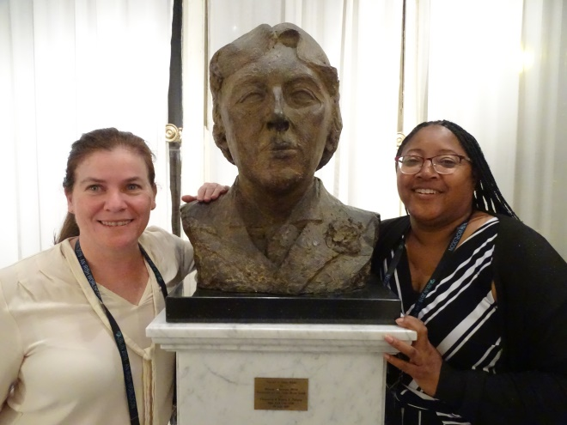
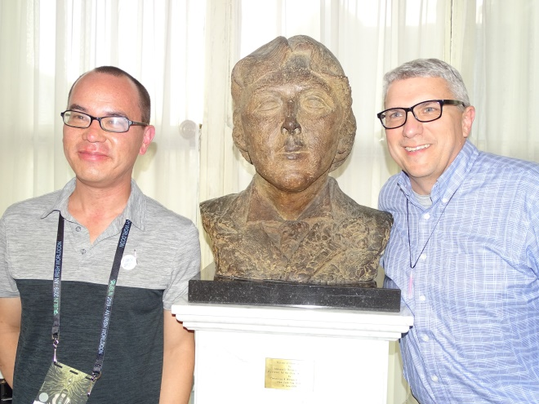
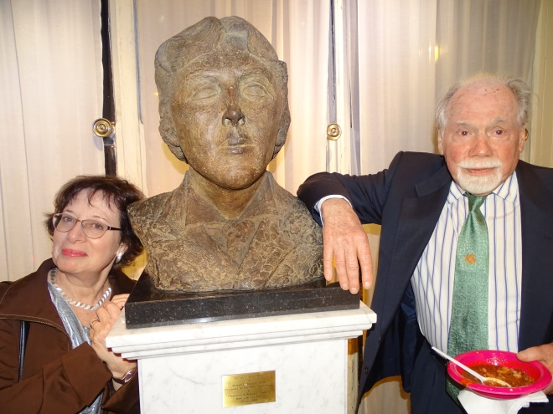
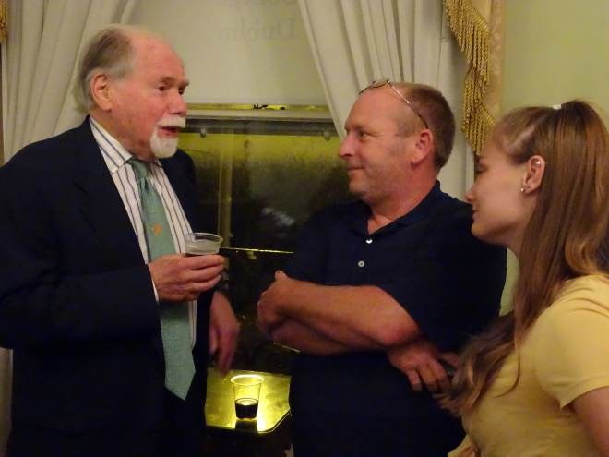
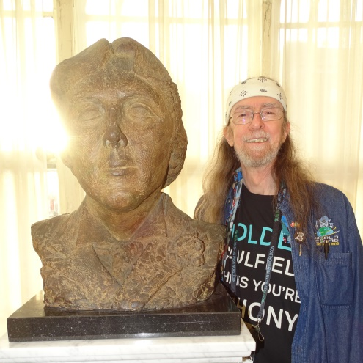
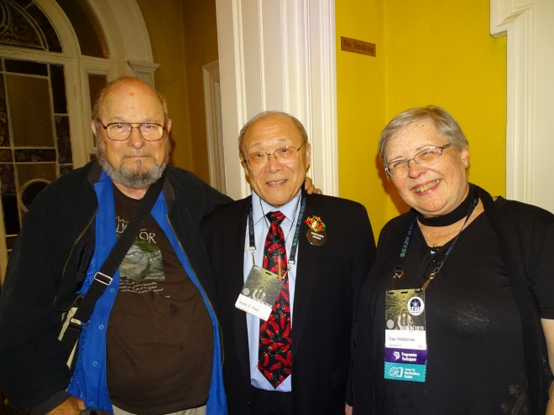
SF authors Catherine M. Walker from
Australia, Maquel A. Jacob
from Portland, Oregon
Hugo nominee Alec Nevala-Lee and
Elections Chair Will Hamilton
Karen Haber Silverberg and SFWA
Grandmaster Robert Silverberg,
blessing the chili.
SFWA Grandmaster Robert
Silverberg, John Campbell Hammond
(John W. Campbell, Jr.’s grandson) and
Hammond’s daughter.
Member and 2018 Worldcon
Guest of Honor
Spider Robinson
SFWA Grandmaster/Director Joe
Haldeman, Dr. Keith Kato, and Gay
Haldeman

Slide 4
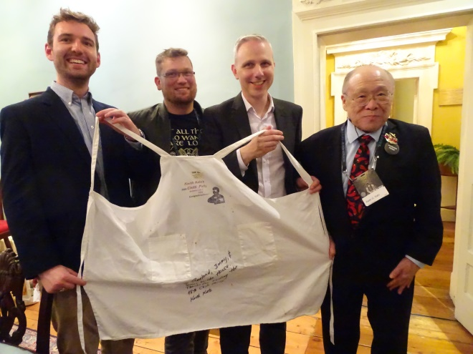
Jimmy O’Connell (Wilde House),
Jason Aukerman (Bradbury Center),
Rowland Crawte (Wilde House) and
Dr. Keith Kato (THS). Souvenir apron says
“To Rowland, Jimmy, & Oscar Wilde
House. Thanks for hosting the 45th Chili
Party. /s/ Keith Kato”
Dr. Keith Kato (THS).
“Mission
Accomplished”

